Slide 1
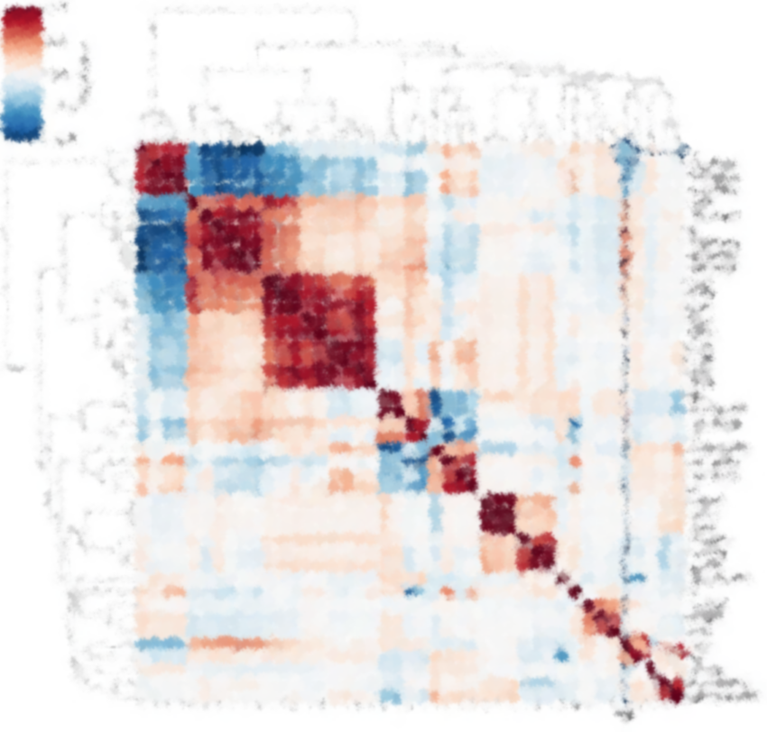
CNS2022
pyspi: python toolkit for statistical analysis of pairwise interactions
Package author: Oliver Cliff
Workshop presenter: Annie G. Bryant
16 July 2022
Dynamics and Neural Systems Lab
The University of Sydney
https://github.com/olivercliff/pyspi/
Notes:
Hi! I’m Annie Bryant, a PhD student in the Dynamics and Neural Systems lab at the University of Sydney. So far today, we’ve heard about two tools for highly comparative analysis of univariate time-series, and now we're going to switch gears a bit and take things to the next dimension with pairwise time-series analysis. I’ll be presenting on behalf of Oliver Cliff, who wrote the pyspi package to analyze pairwise interactions in multivariate time series.

Slide 2
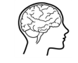
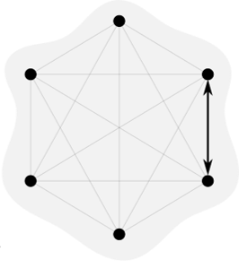
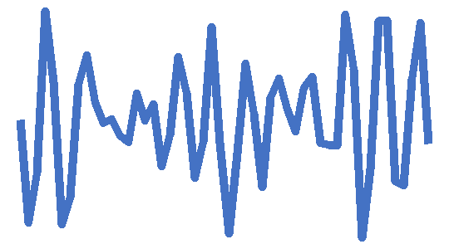

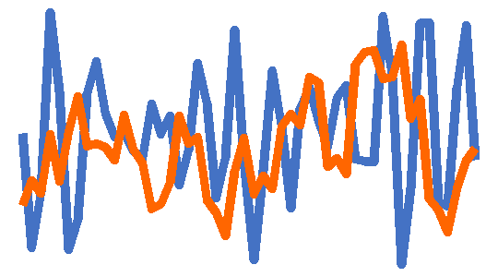
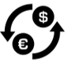
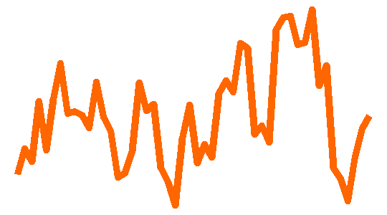
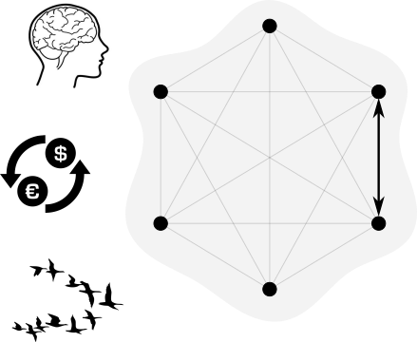
What are pairwise interactions?
Features that capture the relationship between the two nodes’ time-series
Pairwise interactions are studied across disciplines
Neuroscience: Connectivity measures
Econometrics: Interactions between assets
Biology: Leader/follower in collective motion
Slide adapted courtesy of Oliver Cliff
Notes:
First, it would be helpful to get us all on the same page about what pairwise interactions are. If you have a network of two or more nodes where each node has its own measured time series,
[click] you can derive various statistical properties about how any two time series relate to each other.
[click] Pairwise interactions are used across diverse disciplines, including
[click] Neuroscience, with connectivity measures between regions or voxels;
[click] Econometrics, where you can examine the interactions between assets; and
[click] Biology, where you can study interactions between a leader and a follower in collective motion like bird flight formations.
[click] To sum it up, pairwise interactions are pretty much everywhere.

Slide 3
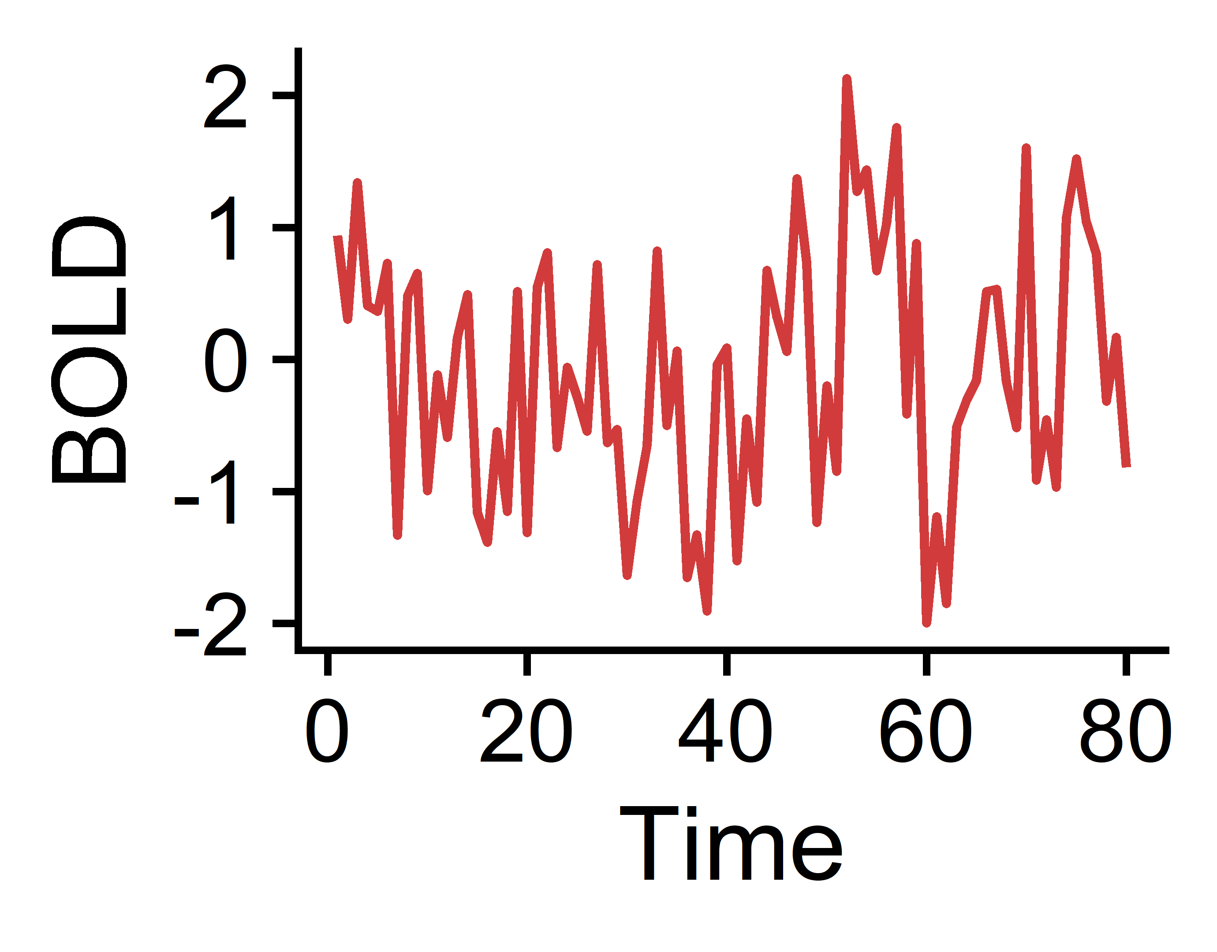
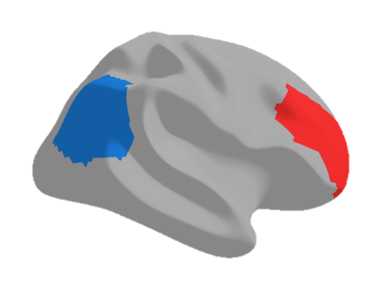
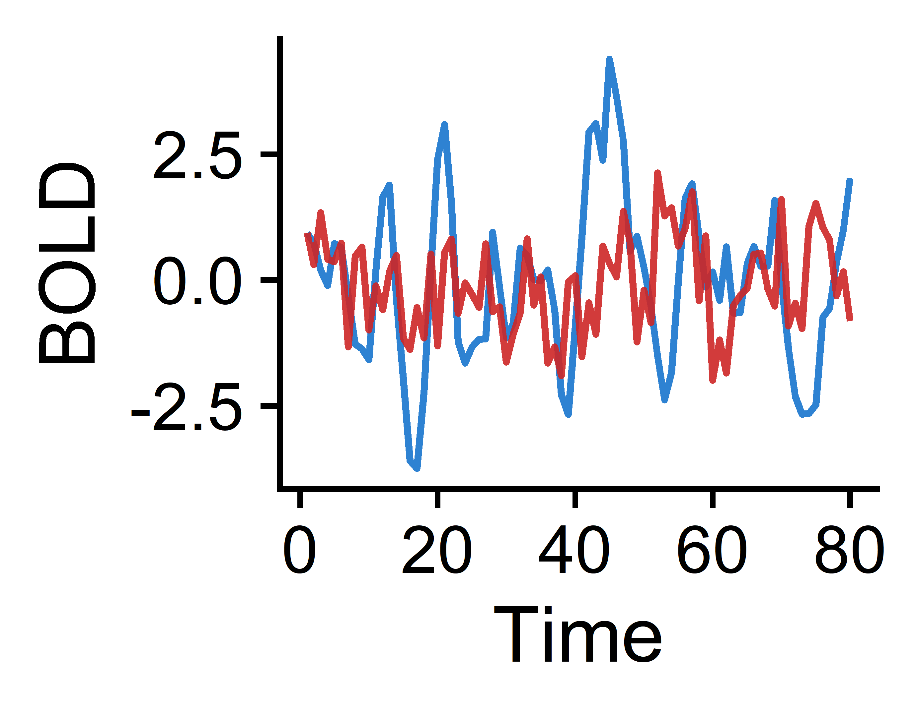
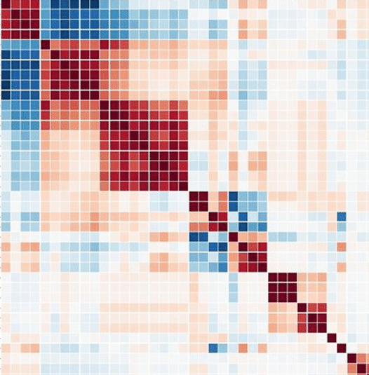
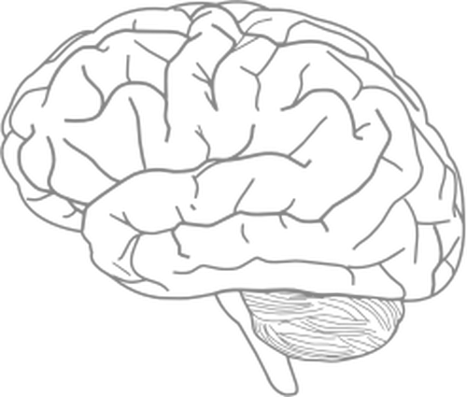
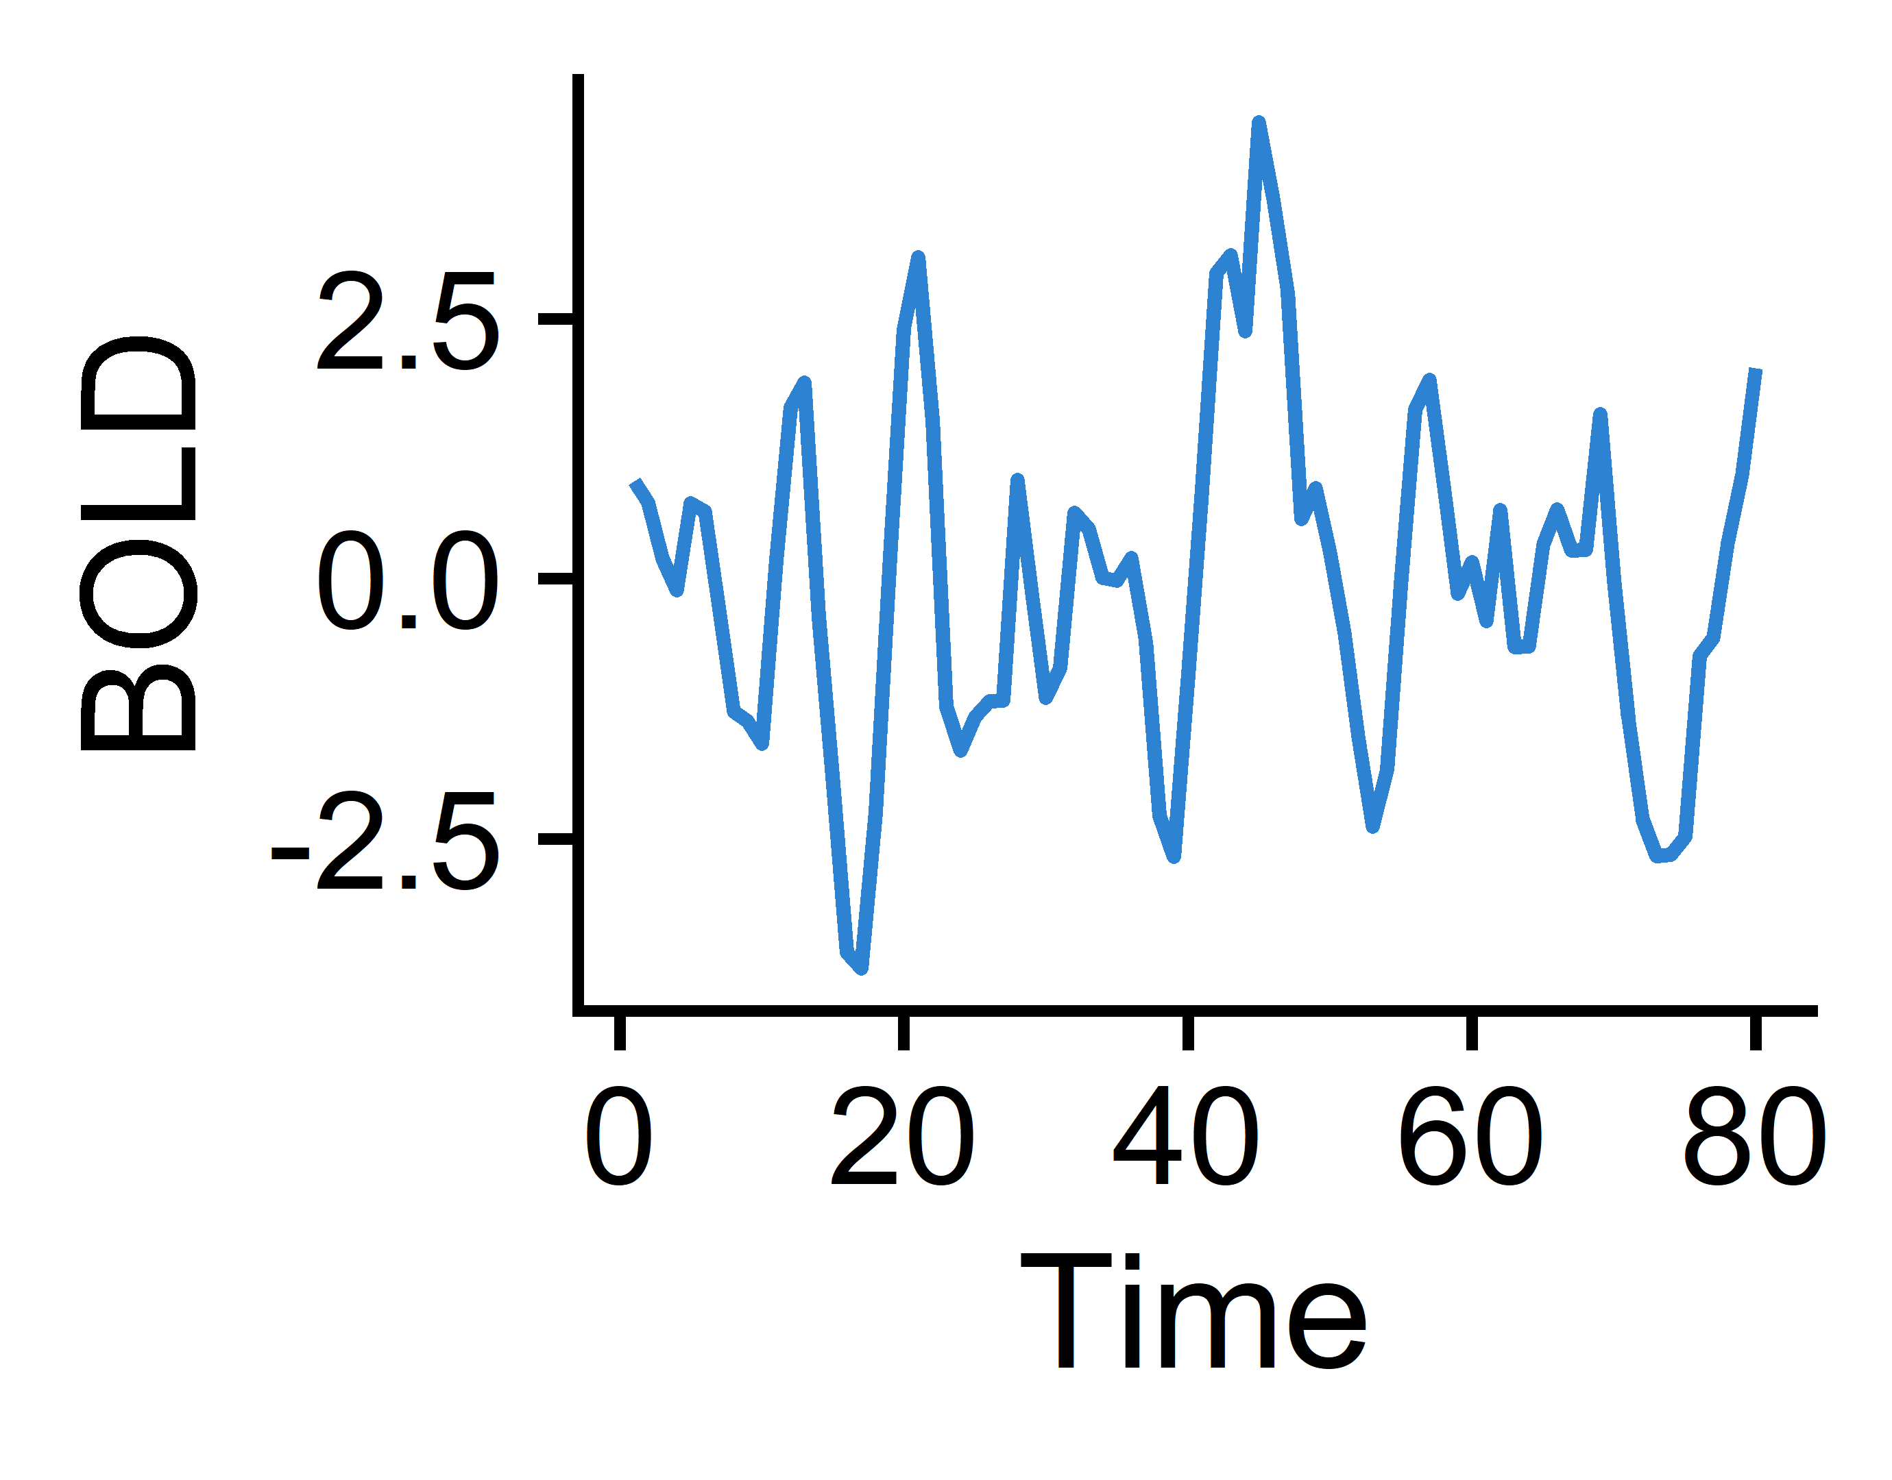
How are pairwise interactions typically explored in computational neuroscience?
Region 2
Region 1
Multivariate time-series
Calculate Pearson correlation coefficient (PCC) between two regions’ time-series
Combine PCCs across all region pairs to construct a functional connectivity (FC) matrix
Regional functional magnetic resonance (fMRI) signals
Notes:
As I mentioned, pairwise analysis is already very much present in computational neuroscience. Typically, it’s done using functional magnetic resonance imaging or fMRI time-series, where you might examine the amount of blood flowing through each region over time as a proxy for neural activity.
[click] So generally, you might combine the time-series from two regions, here showing the inferior parietal cortex in blue and the middle frontal cortex in red;
[click] Then you calculate the Pearson correlation coefficient for the fMRI signal values at each time point between the two regions; and
[click] After doing this for every combination of regions, you construct a correlation matrix, which forms the basis for generating a functional connectivity network.

Slide 4
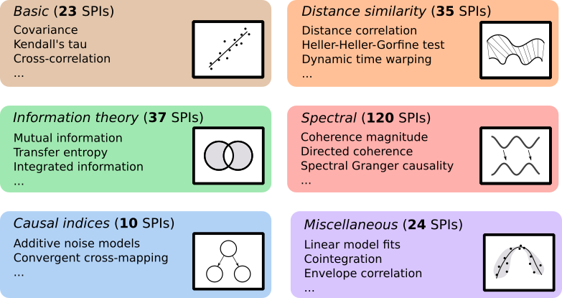
What else is out there?
pyspi
Pearson correlation
Cointegration
Transfer entropy
Comprehensive library of 249 statistical pairwise interactions derived from multiple disciplines of research
Cliff et al. 2022 (arXiv)
Notes:
Pearson correlation-based functional connectivity networks undoubtedly afford great insight into how pairs of regions interact to form a functional network, but this is just one of many ways to quantify the relationship between two time-series. Which begs the question, what else is out there that might be missing from computational neuroscience? What interdisciplinary properties from domains like information theory and causal inference could be tapped to expand our understanding of functional connectivity?
[click] with that in mind, Oliver and collaborators developed pyspi, which contains a comprehensive library of 249 statistical pairwise interactions (SPIs) derived from multiple disciplines of research.

Slide 5
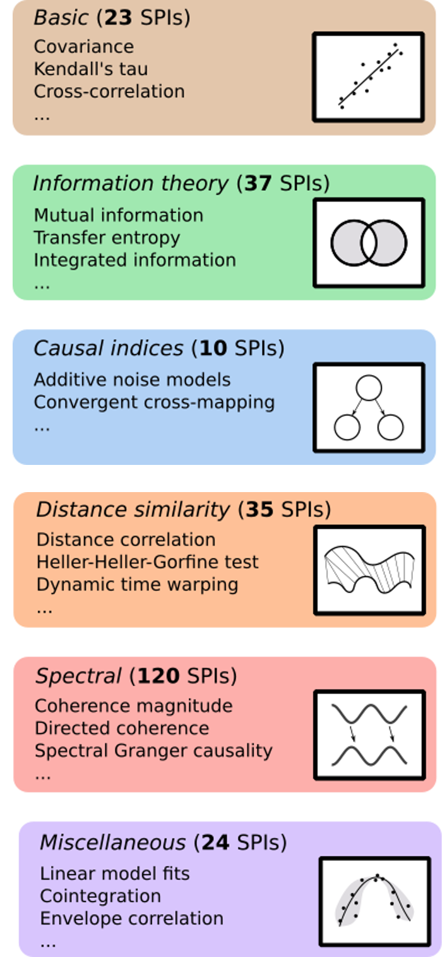
I pyspi with my little eye-spi…
… an open-source python package for highly comparative multivariate time-series analysis!
Time points
SPIs 1-249
Choose which SPIs to calculate
Run pyspi with Calculator.compute()
Processes (e.g. brain regions)
Processes
(default is all 249)
Processes
Input: a tabular dataset of processes by time points
Output: a set of tabular datasets containing pairwise values for each pair of processes by SPI
https://github.com/olivercliff/pyspi
Notes:
Pyspi is an open-source python package for highly comparative multivariate time-series analysis.
[click] As an overview of the pyspi workflow, you start with a tabular dataset containing processes (like brain regions) by time points.
[click] You then choose which SPIs to calculate, with the default being the full suite of 249 SPIs.
[click] Then, you run pyspi with the Calculator.compute() function, which we will go over in the coding demo portion. And this generates a set of tabular datasets containing the pairwise values for each pair of processes, grouped by SPI.

Slide 6
How can pyspi revolutionise how we look at functional connectivity in the human brain?
Region 2
Region 1
Calculate Pearson correlation coefficient (PCC) between two regions’ time-series
Combine PCCs across all region pairs to construct a functional connectivity (FC) matrix
Multivariate time-series
Regional BOLD fMRI signals
Calculate 248 other SPIs that capture distinct relationships between two brain regions’ activities
Examine many diverse types of FC in the brain in health and disease
Notes:
It’s worth highlighting specifically how this framework can revolutionise how we look at functional connectivity in the brain.
[click] With pyspi, you can still calculate pairwise Pearson correlation coefficients and construct a Pearson-based functional connectivity network;
[click] But you also now have access to up to 248 additional pairwise dynamics that capture distinct relationships between two brain regions’ activities that allow you to explore many diverse types of functional connectivity in the brain, in both health and disease.

Slide 7
Let’s get pySPI running!
Key links
https://github.com/olivercliff/pyspi
https://pyspi-toolkit.readthedocs.io/en/latest/
https://wiki.octave.org/Category:Installation
https://www.anaconda.com/products/distribution
Quick steps to install
[OPTIONAL] install octave on your machine from above link
[OPTIONAL] create a specific conda environment for pyspi
conda create –n pyspi python=3.9.0
conda activate pyspi
Clone the pySPI github repo to your machine
e.g. git clone https://github.com/olivercliff/pyspi.git
Navigate to downloaded repo
e.g. cd ~/pySPI
python3 –m pip install .
Notes:
I’ve put the steps to install pySPI together here to show that it’s a straightforward installation using the pip module from python after you clone Oliver’s github repo. You can optionally install octave on your machine to access some SPIs that require an octave workspace, and you can also optionally install pyspi in a specifically-created conda environment which is what I opted to do.

Slide 8
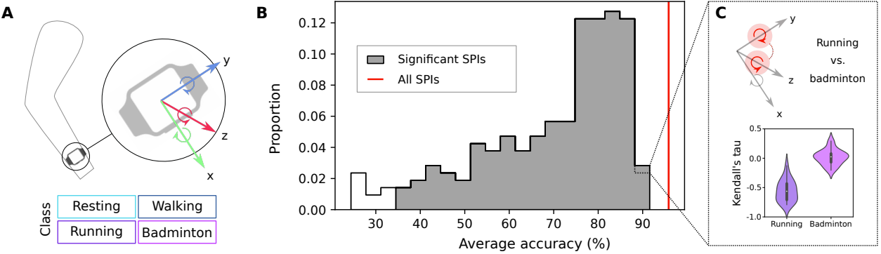
Downstream application example: classifying actigraphy data
MTS data from 3-axis accelerometer and 3-axis gyroscope recording
216 SPIs used as basis for linear support vector machine (SVM) classifier, with cross-validated accuracy reported
Zoom in on high-performing SPIs like Kendall’s τ
Cliff et al. 2022 (arXiv)
Notes:
As an example for how pyspi has been applied thus far, Oliver examined multivariate actigraphy time-series data, acquired from 3-axis accelerometer and 3-axis gyroscope recordings.
[click] Oliver examined 216 SPIs (which were those out of the 249 that returned non-constant scalar values) and used each of these as the basis for linear support vector machine (SVM) classification, with cross-validated accuracy used as the performance metric.
[click] This type of analysis allows you to zoom in on the highest-performing SPIs for a dataset, which in this case included Kendall’s tau (which is a rank-based non-parametric correlation metric). This gives interpretable insight that Kendall’s Tau distinguishes running from badminton due to their differential associations between the wrist’s rotations along the y and z rotation axes.

Slide 9

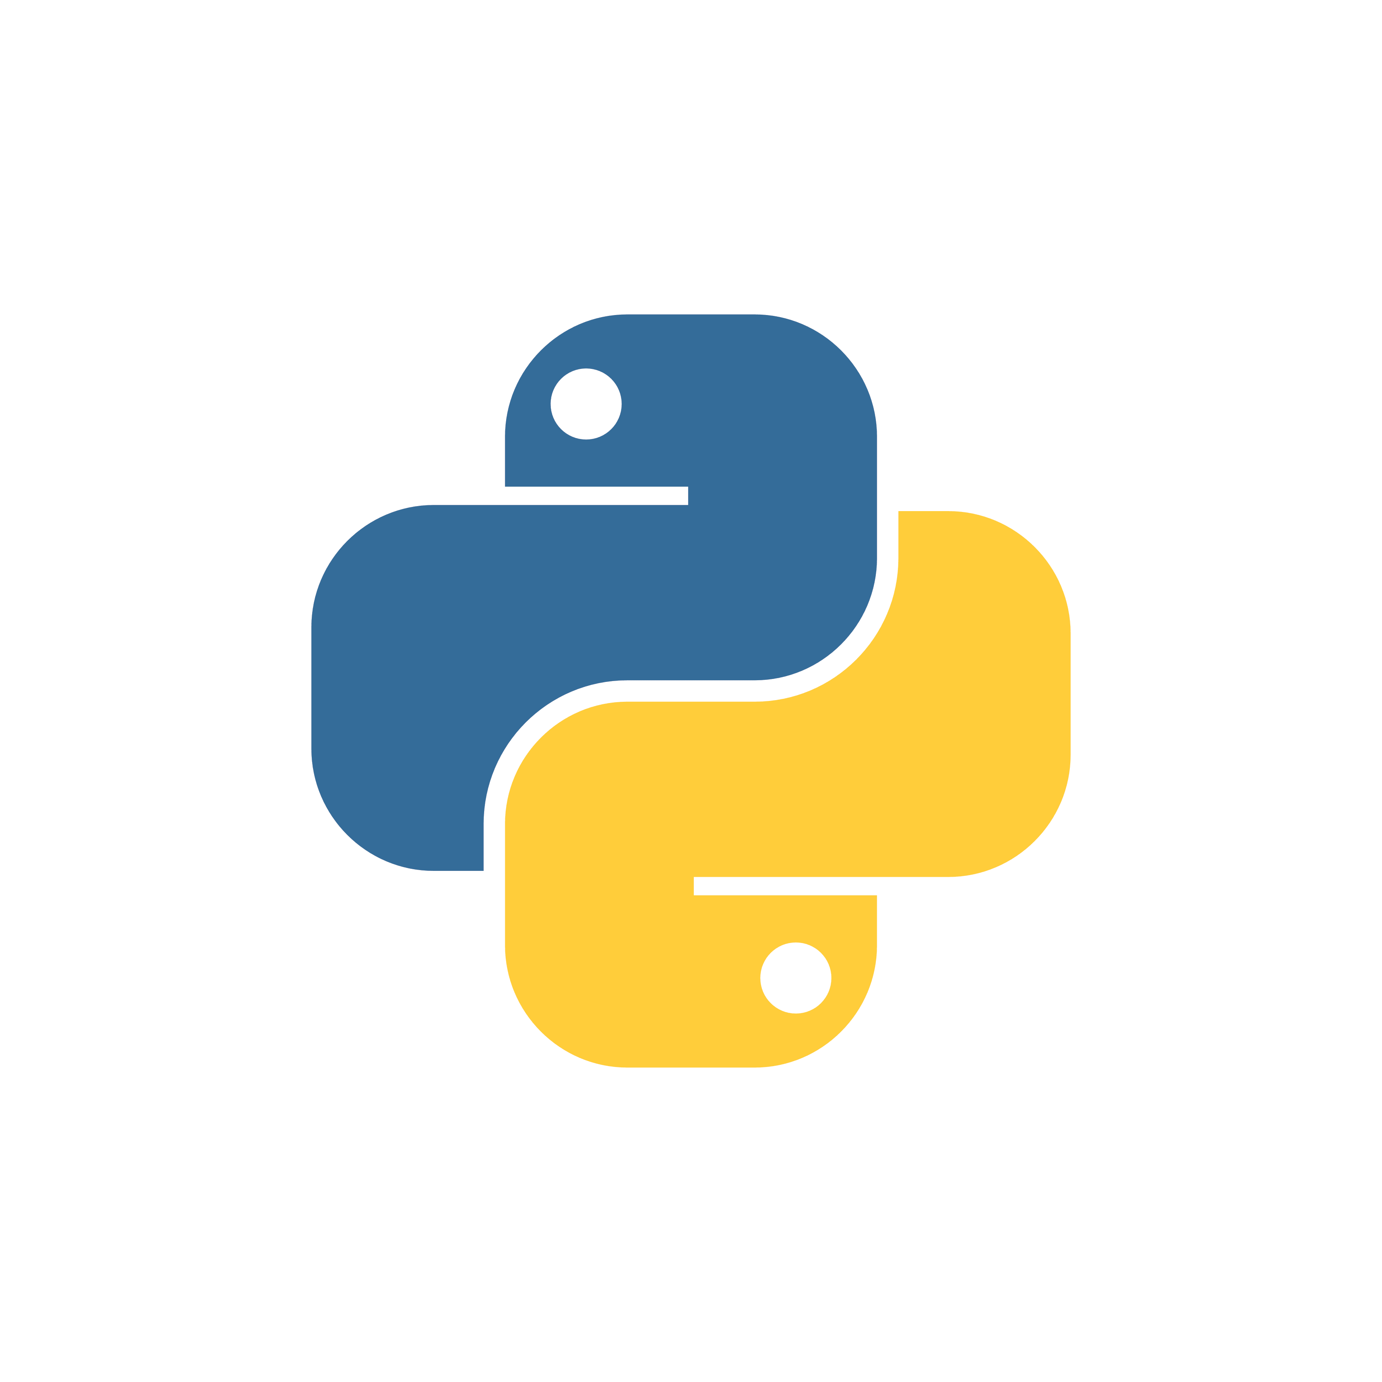
Applying pyspi to BOLD fMRI time-series data
Tutorial data: one participant from the UCLA Consortium for Neuropsychiatric Phenomics LA5c Study¹
Data is split up into 4 sets of 4 brain regions, each of which has 152 time points (fMRI frames)
We will go through:
Preparing our multivariate time-series data to be in the right format
Visualizing the raw time-series data
Running pyspi on our four datasets
Extracting the resulting SPIs and combining them across the 4 sets
Visualizing our SPI output
More in-depth tutorial: https://github.com/olivercliff/pyspi/blob/main/demos/tutorial.ipynb
¹Gorgolewski KJ et al. A Preprocessed consortium for Neuropsychiatric Phenomics dataset. (2017).
Notes:
For our coding demo today, we will apply pyspi in a more comp neuro setting using fMRI data from the UCLA Consortium for Neuropsychiatric Phenomics LA5c Study. We will use data sampled from one anonymous participant, looking at four sets of four brain regions, each of which has 152 time points corresponding to fMRI frames.
We’ll go through the general workflow for running pyspi, including data prep and visualization, running pyspi, extracting the calculated SPIs, and visualizing the output. This work is just a sampling of pyspi’s functionality, and for a more in-depth tutorial, I would point the interested reader toward Oliver’s tutorial in his repo. This covers everything in today’s demo along with more advanced classification analyses.

Slide 10
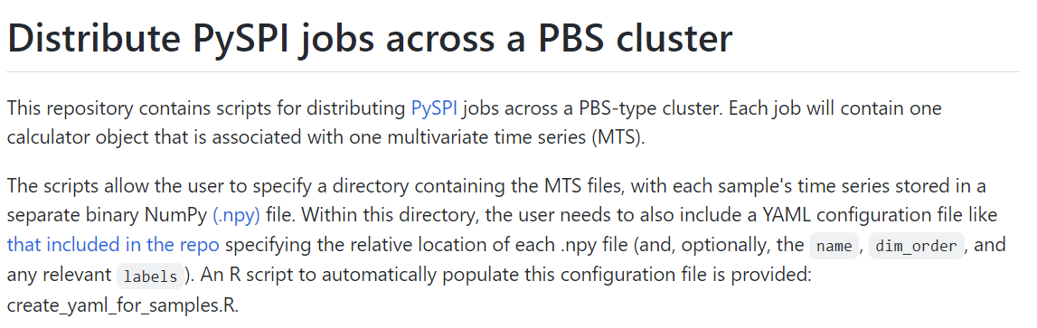


Ways we’re improving pyspi accessibility
pyspi-distribute
https://github.com/olivercliff/pyspi-distribute
Interfacing with R
reticulate package
https://rstudio.github.io/reticulate/
Notes:
I’m working with Oliver on a couple of ways to improve the accessibility and user friendliness of pyspi, one of which is a parallelized version of pyspi designed to run on a high-performance computing cluster. This has its own repo called pyspi-distribute which can be found at the link included here, and is designed for users who want to scale up to analyse a large number of multivariate time-series datasets. We won’t go through this explicitly in the demo, but please feel free to flag me down during the last hour of the tutorial if you’re interested in learning more then.
[click] The second way we’re expanding accessibility is by interfacing with R using the reticulate package from Rstudio. I’m an R gal through and through and prefer to do all my data wrangling and visualization within R’s tidyverse, so I have included some code in the demo for porting the pyspi results to R. We can go through this if time allows, otherwise this is also something you can chat to me about in the final hour.

Slide 11



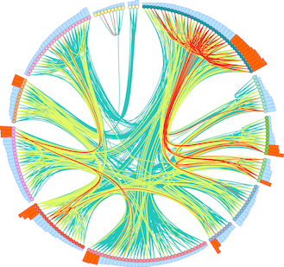

Thank you! Any questions?
Oliver M. Cliff
pyspi author
https://github.com/olivercliff
With support from:
The University of Sydney Physics Foundation
Ben D. Fulcher
Supervisor
Dynamics and Neural Systems Lab
School of Physics
The University of Sydney
The American Australian Association Graduate Education Fund
Notes:
And with that, I’d like to shout out Oliver who wrote pyspi but couldn’t be here today, as well as Ben for being a super supervisor to our whole group. If time allows, I’ll happily answer questions, otherwise happy to chat during the coding demo and subsequent data exploration hour.

